Slide 1

Ease your life with T.D.D.
Zoltán Domahidí senior Java developer

Slide 2

Contents
Introduction to software testing
What is wrong with test-last development?
What is Test-Driven Development?
Why TDD is important?
TDD misconceptions
Acceptance TDD
A short note about XP

Slide 3
Introduction to software testing
Test: a procedure intended to establish the quality, performance, or reliability of something, especially before it is taken into widespread use.
Software testing involves the execution of a software component or system component to evaluate one or more properties of interest:
meets the requirements that guided its design and development
responds correctly to all kinds of inputs
performs its functions within an acceptable time
is sufficiently usable
can be installed and run in it’s intended environments
achieves the general result it’s stakeholders desire
Notes:
https://en.wikipedia.org/wiki/Software_testing

Slide 4
Software testing is a verification and validation process
Verification: are we building the product right?
Validation: are we building the right product? (see ATDD)
Notes:
Verification is about testing techniques
Validation is about requirements and goals of the stakeholders
https://en.wikipedia.org/wiki/Software_verification_and_validation

Slide 5
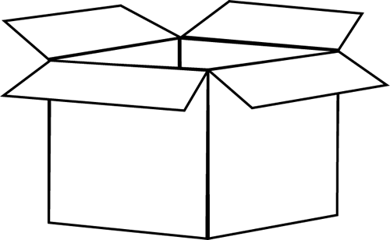

Notes:
White-box testing's basic procedures require the tester to have an in-depth knowledge of the source code being tested. (unit tests)
Black-box testing is a method of software testing that examines the functionality of an application without peering into its internal structures or workings. The tester is aware of what the software is supposed to do but is not aware of how it does it. (almost every tests except unit tests, and integration tests in the most cases)
A gray-box tester partially knows the internal structure, which includes access to the documentation of internal data structures as well as the algorithms used. (integration tests)

Slide 6


Slide 7
Test doubles
removes external dependencies
creates known state
focus test on a specific code path
types:
Stubs: provides canned or no answer to calls during the test
Fakes: working implementation with some shortcuts (not suitable for prod.)
Mocks: objects pre-programmed with expectations what can be verified
Notes:
If an object has any of the following characteristics, it may be useful to use a mock object in its place:
the object supplies non-deterministic results (e.g. the current time or the current temperature);
it has states that are difficult to create or reproduce (e.g. a network error);
it is slow (e.g. a complete database, which would have to be initialized before the test);
it does not yet exist or may change behavior;
it would have to include information and methods exclusively for testing purposes (and not for its actual task).
https://stackoverflow.com/questions/346372/whats-the-difference-between-faking-mocking-and-stubbing
https://en.wikipedia.org/wiki/Test_double
https://agilewarrior.wordpress.com/2015/04/18/classical-vs-mockist-testing/

Slide 8
Types of testing
Unit tests
Integration tests
Functional/Acceptance tests
Performance tests
Regression tests
Manual tests
Notes:
CDC testing https://martinfowler.com/articles/consumerDrivenContracts.html

Slide 9
Types of testing
Unit tests
shows that individual parts works correctly in isolation
testing smallest unit of functionality
fast and reliable
everything should be done in memory (network, file system, database)
any dependency that is hard to understand, initialise or manipulate
should be stubbed or mocked
cover most of your codebase
use for development and refactoring
living documentation
Notes:
Unit tests:
Smallest unit of functionality, typically testing a method or a function
Focusses on one particular feature
Everything it touches should be done in memory
Unit tests do not:
Access the network
Hit a database
Use the file system
Create new threads
Any kind of dependency that is hard to understand, initialise or manipulate should be stubbed or mocked
as simple as possible
Easy to debug
Reliable (due to reduced external factors)
Fast to execute
Cover most of your codebase
Cover almost all known use cases
Follow clean code principles
Be executed whenever a change is committed
Use it for development and refactoring
https://en.wikipedia.org/wiki/Unit_testing
Helps to:
Find problems early
Simplifies integration
Facilitates change
Documentation
Design

Slide 10
Types of testing
Integration tests
individual modules are tested as a group
verify the communication paths and interactions between components
much slower than unit test
more complicated to set-up and debug

Slide 11
Types of testing
Functional tests
check a particular feature for correctness
intermediate results are not relevant (it works or doesn’t)
internal program structure is rarely considered
required applications should be up and running (nothing is mocked)
verifies a program by checking against specifications
very hard to create and maintain
very slow, should run once a day
logs are important to track problems
Notes:
Functional tests:
Check a particular feature for correctness by comparing the output for a given input against the specification
Do not concern themselves with intermediate results or internal program state (as if in blackbox testing)
The function either works or doesn’t
Required applications (webapps, brokers, databases, etc) should be up and running before the tests
https://en.wikipedia.org/wiki/Functional_testing
Functional testing differs from system testing in that functional testing "verifies a program by checking it against ... design document(s) or specification(s)", while system testing "validate[s] a program by checking it against the published user or system requirements"

Slide 12
Types of testing
Acceptance tests
particular type of functional tests
if all passes, it means software should meet all user requirements
and it is feature complete
Notes:
Acceptance tests:
Check a particular feature for correctness by comparing the output for a given input against the specification

Slide 13
Types of testing
Performance tests
used to determine the system’s behavior under normal
and peak load conditions
helps to identify maximum operating capacity and bottlenecks
requires a specific production-like environment
Notes:
https://en.wikipedia.org/wiki/Software_performance_testing

Slide 14
Types of testing
Regression tests
verifies that changes does not introduced any faults
new bugs or regressions may be uncovered
requires a specific production-like environment
Notes:
https://en.wikipedia.org/wiki/Regression_testing

Slide 15
Types of testing
Manual tests
human testers checks predefined scenarios
main flows are tested usually
requires a specific production-like environment
checking the correct behavior prior to release to end users

Slide 16
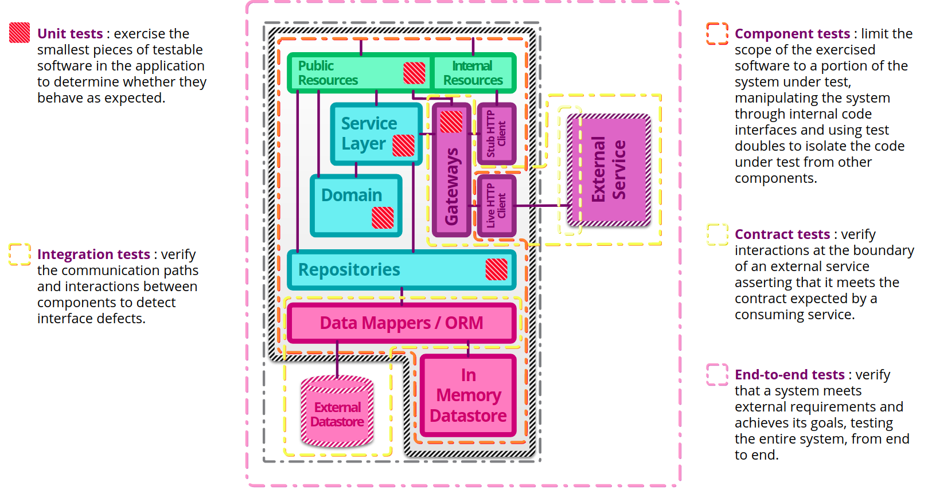
Notes:
https://martinfowler.com/articles/microservice-testing/

Slide 17
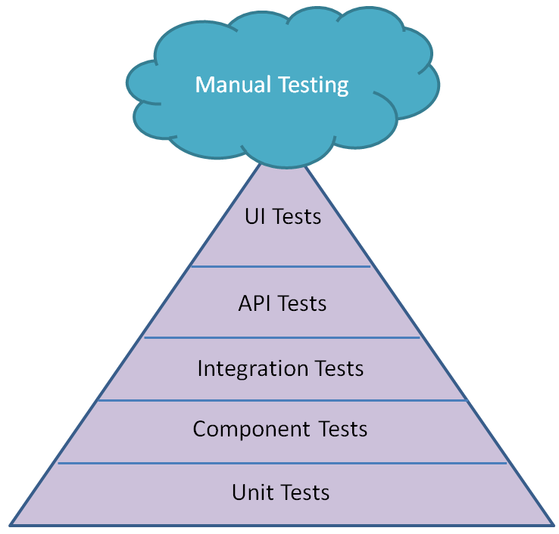
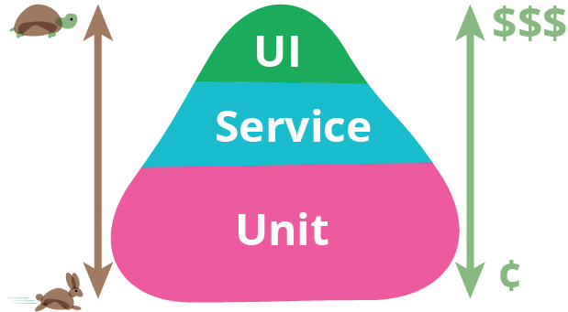
Testing pyramid
Notes:
In general, the more coarse grained a test is, the more brittle, time consuming to execute and difficult to write and maintain it becomes. This additional expense stems from the fact that such tests naturally involve more moving parts than more fine grained focussed ones.
The concept of the test pyramid is a simple way to think about the relative number of tests that should be written at each granularity. Moving up through the tiers of the pyramid, the scope of the tests increases and the number of tests that should be written decreases.

Slide 18
Bad tests are only slightly better than NO tests
“Code without tests is a bad code” - Michael C. Feathers
Project(s) without tests often end up looking like they are stuck together with duct tape… Change one part and the other part stops working

Slide 19
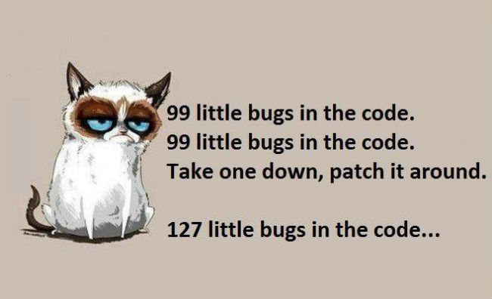

Slide 20
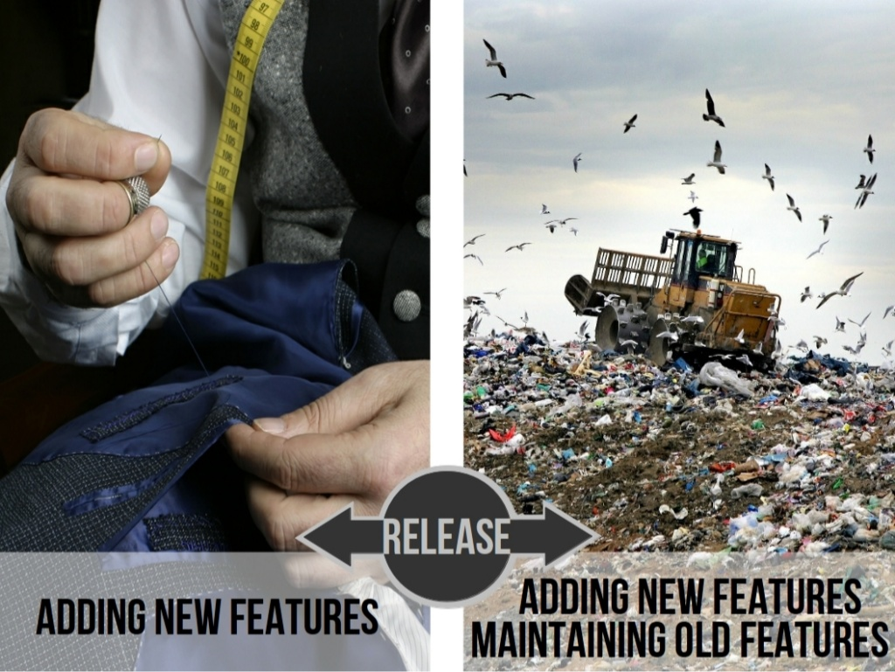

Slide 21


Slide 22
Smells
constructor/method/class does too much work (SRP)
instantiation by using new keyword (hard-coded dependencies)
anything more than field assignment in constructor
too many fields
class has fields used only in some methods
too many dependencies
excessive scrolling
high maintenance cost

Slide 23
Smells
no / meaningless asserts in tests
testing private / protected methods
extensive setup / teardown
brittle tests
slow tests
Notes:
Readable asserts, i.e. : don’t use assertEquals(list.size(), 0) while you could assertTrue(list.isEmpty())

Slide 24

Don’t let your software rot!

Slide 25
“If the answer is not obvious,
or it looks like the test would be ugly or hard to write,
then take that as a warning signal.
Your design probably needs to be modified;
change things around until the code is easy to test,
and your design will end up being far better for the effort”
Notes:
Andy Hunt, Dave Thomas: Pragmatic Unit Testing in Java with Junit

Slide 26
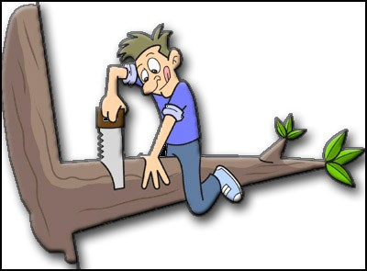

Slide 27
Problems with test-last approach:
errors in production
programmers moves onto other projects
test and code written by different programmers
tests based on outdated information
infrequently testing
fixes that create other problems

Slide 28
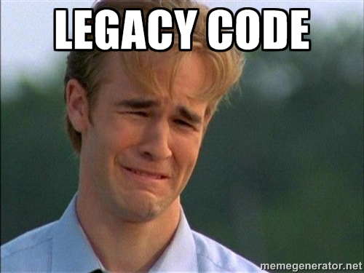
Legacy code is:
code you’re afraid to change
code without tests

Slide 29
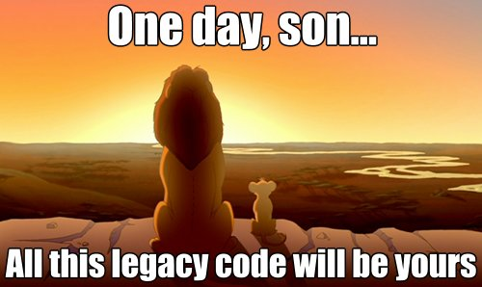

Slide 30
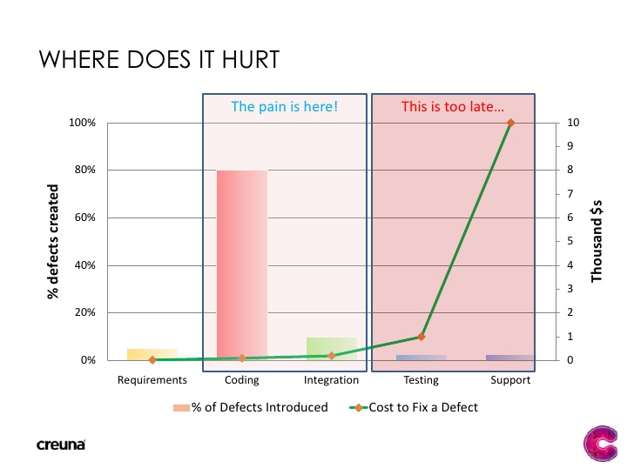
Notes:
https://www.sitepoint.com/javascript-testing-unit-functional-integration/

Slide 31
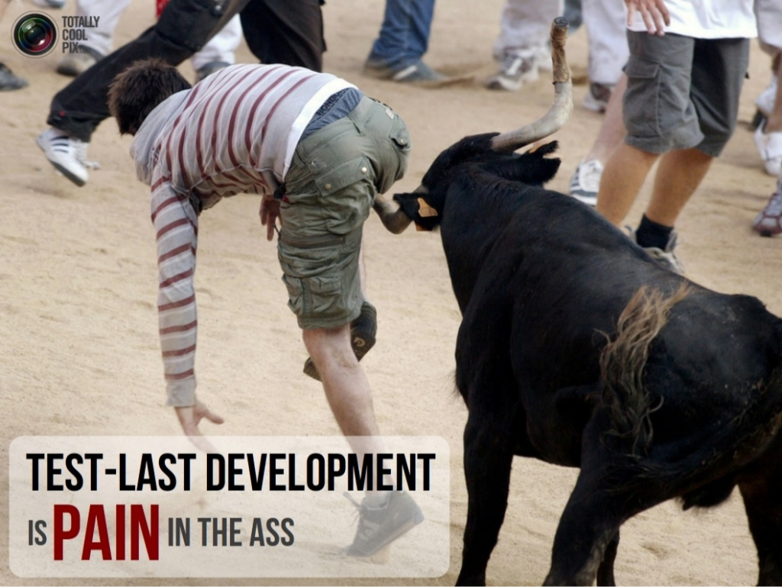

Slide 32
How to write good tests
“The secret of testing is writing testable code” - Misko Hevery

Slide 33
How to write good tests
the name should clearly describe the purpose of the test
Given / When / Then + readability
each test should be for a single concept (1 assert)
test in isolation
Notes:
Best practices: test naming and structure
The name of the test should describe a feature of specification
The name should clearly describe the purpose of the test
Each test should be for a single concept
Strive for one assertion per test (or as few as possible -> more than one may indicate more than one concept is being tested)
What does the object do, not what is the object
Given\Arrange (setup)
The state of the application in order for the scenario to run successfully
When\Act (trigger)
The action that has to be completed in the current scenario
Then\Assert (verification)
The acceptance criteria that the scenario uses in order to ensure success

Slide 34
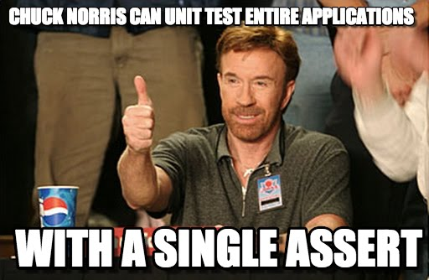

Slide 35
How to write good tests
the name should clearly describe the purpose of the test
Given / When / Then + readability
each test should be for a single concept (1 assert)
test in isolation
Fast: to run them frequently
Independent: of each other
Repeatable: in any environment
Self-Validating: either passing or failing
Timely: written before the production code
Notes:
Good unit tests (Kent Beck)
Express intent, not implementation details
Run fast (they have short setups, run times, and breakdowns)
Run in isolation (reordering possible)
Run in parallel
Use data that makes them easy to read and to understand
hundreds of tests should run under 1 sec
https://technologyconversations.com/2013/12/24/test-driven-development-tdd-best-practices-using-java-examples-2/
https://examples.javacodegeeks.com/core-java/junit/junit-best-practices/
http://www.kyleblaney.com/junit-best-practices/
https://dzone.com/articles/unit-testing-best-practices
https://www.javaworld.com/article/2076265/testing-debugging/junit-best-practices.html

Slide 36
“Experience is a hard teacher
because she gives the test first,
the lesson afterward.”
/ Chinese proverb /

Slide 37
What is Test-Driven Development?
Test-driven development (TDD) is an evolutionary approach to development
which combines test-first development where you write a test
before you write just enough production code to fulfill that test and refactoring.
In other words, it’s one way to think through your requirements or design
before your write your functional code.
Notes:
http://agiledata.org/essays/tdd.html

Slide 38
What is Test-Driven Development?
“TDD is risk averse programming,
investing work in the near term
to avoid failures later on”

Slide 39
What is Test-Driven Development?
It’s a design technique:
lets you think “how to use” first,
rather than “how to implement”
Notes:
Almost that powerful as Pair-Programming, but you can practice this alone!
Tip: Always think first about how to use a feature than how to implement, otherwise the implementation will affect the feature and makes it more complicated to use.

Slide 40
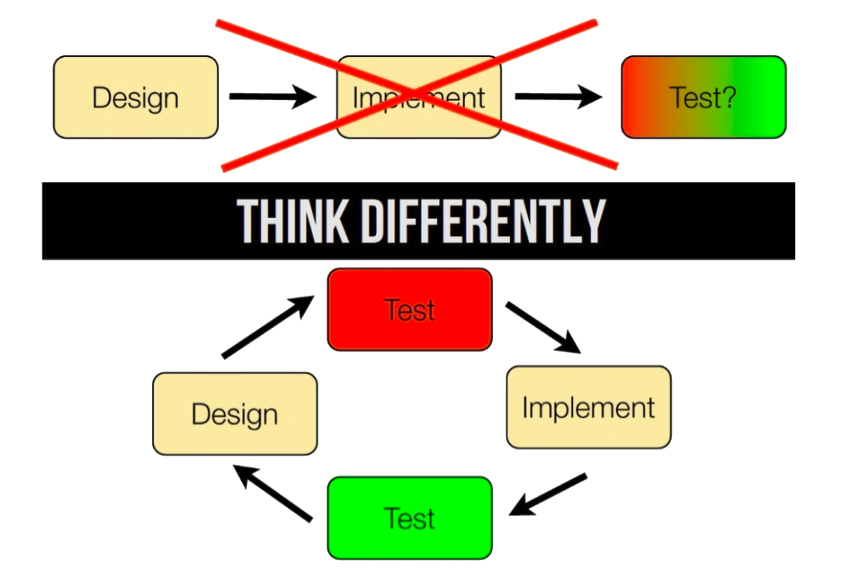
Notes:
Recommended process:
Check if all current tests are passing
Do up-front design and list new tests
Implement one (failing) test at a time
Implement just enough code to pass
Refactor the code and clean up design
Repeat until all tests are passing
Test-last only the legacy systems. Discover dependencies and write tests before touching any code.

Slide 41
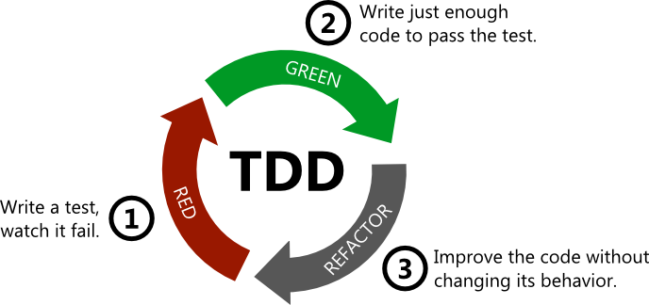
The Three Laws of TDD
You are not allowed to write any production code unless it is to make a failing unit test pass.
You are not allowed to write any more of a unit test than is sufficient to fail; and compilation failures are failures.
You are not allowed to write any more production code than is sufficient to pass the one failing unit test.
Notes:
http://butunclebob.com/ArticleS.UncleBob.TheThreeRulesOfTdd

Slide 42
Why TDD is important? Why does it work?
The routine leads the programmers to think about details they otherwise don’t.
Specifically, test cases are thoughts through before the programmer is allowed to think about the “interesting part” of how to implement the functionality.
Encourages “divide-and-conquer”.
Programmers are never scared to make a change that might “break” the system.
The testing time that is often squeezed out of the end of a traditional development cycle cannot be squeezed out.
Notes:
Removes fear to change code
Gives fast feedback

Slide 43
Advantages and results
a well designed application
enables change
gives confidence / removes fear
user requirements are more easily understood
validates your design
shortens the programming feedback loop (really fast feedback)
reduced software defect rate and maintenance significantly
less debug time (hard stuff and surprises are tackled early on)
brings professionalism to software development / requires discipline
Notes:
Removes fear to change code

Slide 44
Advantages and results (regarding to code quality)
flexibility
readability
maintainability
predictability
simplicity (KISS)
loosely coupled
YAGNI (no dead code)
SOLID (especially SRP)
“Perfection (in design) is achieved not when there is nothing more to add, but rather when there is nothing more to take away”
“The most powerful designs are always
the result of a continuous process of simplification and refinement.”
Notes:
Predictable - tells you when you are done
“Perfection (in design) is achieved not when there is nothing more to add, but rather when there is nothing more to take away” [C&B - Eric] (Antoine de Saint-Exupéry)
The most powerful designs are always the result of a continuous process of simplification and refinement. —Kevin Mullet, Designing Visual Interfaces: Communication Oriented Techniques

Slide 45
Top 5 excuses for not unit testing / TDD
I don’t have time to unit test
The client pays me to develop code, not write unit test
I am supporting a legacy application without unit tests
QA and User Acceptance Testing is far more effective in finding bugs
I don’t know how to unit test, or I don’t know how to write good unit tests

Slide 46
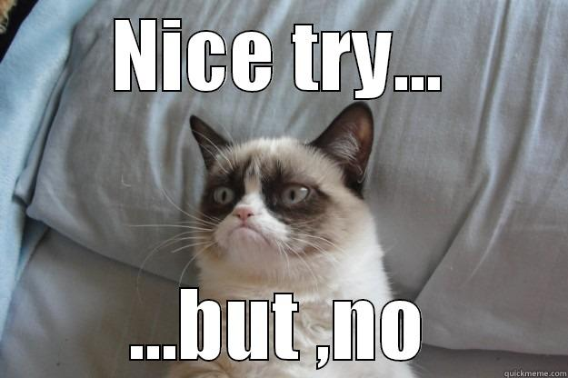

Slide 47
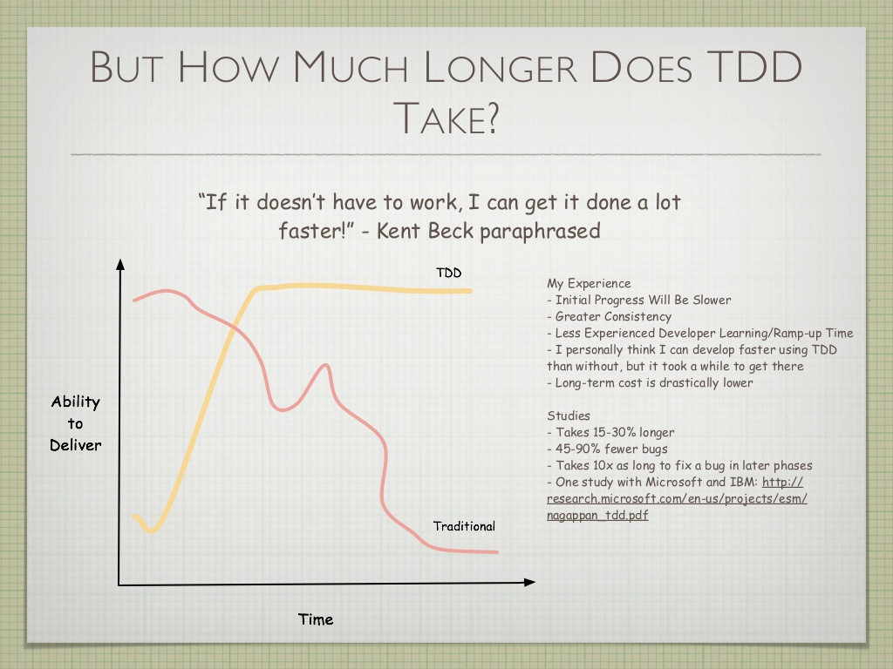
Notes:
https://www.slideshare.net/dehringer/test-driven-development-5785229?qid=542992fb-09b9-47f2-abc5-b146d827a55f&v=&b=&from_search=4

Slide 48
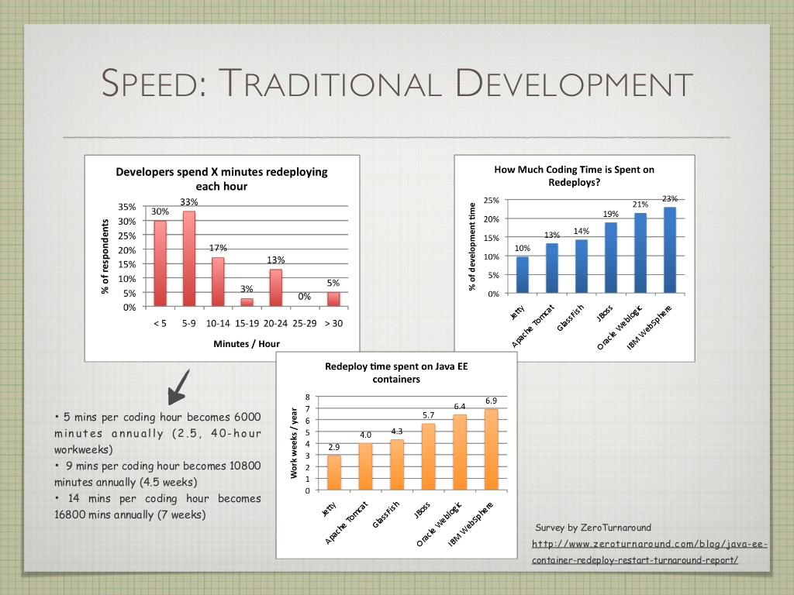

Slide 49
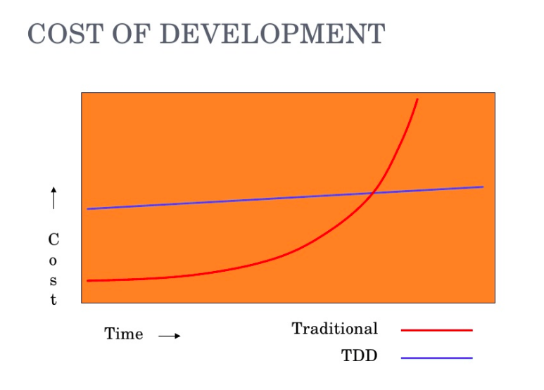

Slide 50
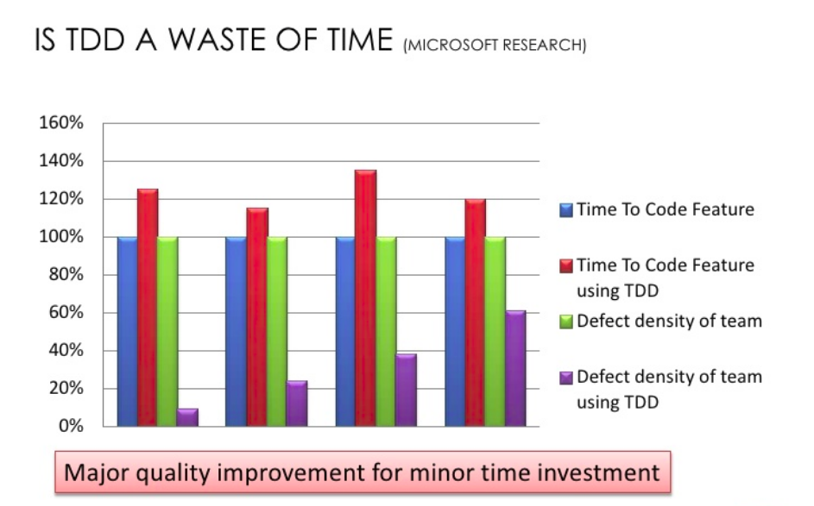
Notes:
The business team doesn’t care at all about the development process you use, as long as it’s effective
Bugs not only wastes developer time, it hurts the company’s brand and quality reputation. For developers context switching can cost up to 20 minutes per bug (doing nothing productive) and then recover the context of the problem they were working on prior to the interruption.
https://medium.com/javascript-scene/5-common-misconceptions-about-tdd-unit-tests-863d5beb3ce9

Slide 51
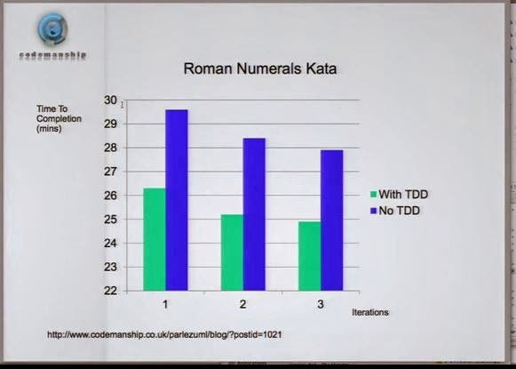

Slide 52
Top 5 excuses for not unit testing / TDD
I don’t have time to unit test
You will need to spend your time to debug and fix defects
The client pays me to develop code, not write unit test
The client pays you to deliver working product
I am supporting a legacy application without unit tests
You will be afraid to improve/change it without tests
QA and User Acceptance Testing is far more effective in finding bugs
It is rather more costly and time consuming
I don’t know how to unit test, or I don’t know how to write good unit tests
Learn it!

Slide 53


Slide 54

TDD challenges:
management doesn’t often
understand “internal quality”
discipline is required
developers are often
stubborn and lazy
it is hard for developers to
drop bad habits
“I’m not a great programmer;
I’m just a good programmer
with great habits” - Kent Beck
Notes:
https://en.wikipedia.org/wiki/Software_testing

Slide 55

How to learn?
coding kata
coding dojo
baby steps
pair programming
patience
Notes:
Explain baby steps:
First return simple values, not a problem if hardcoded
Add more conditions as more tests are written (if / switch)
Always refactor
Kata: every day for 2 weeks
when you are first learning to take a TDD approach it proves require great discipline because it is easy to “slip” and write functional code without first writing a new test. One of the advantages of pair programming is that your pair helps you to stay on track.
http://www.peterprovost.org/blog/2012/05/02/kata-the-only-way-to-learn-tdd/
https://github.com/dwyl/learn-tdd
https://www.codementor.io/ruby-on-rails/tutorial/getting-started-learn-test-driven-development

Slide 56
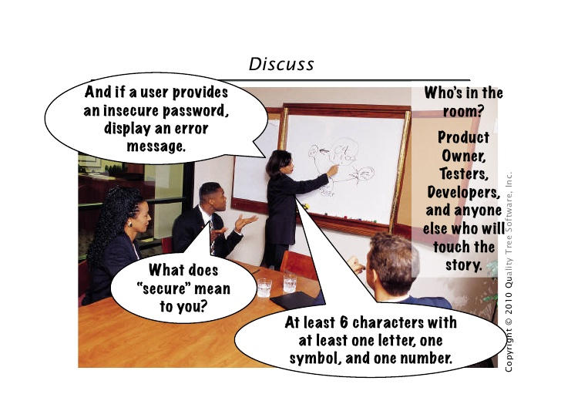
Acceptance Test-Driven Development
ATDD is a development methodology based on communication between the business customers, the developers, and the testers.
Notes:
https://en.wikipedia.org/wiki/Acceptance_test%E2%80%93driven_development
https://www.slideshare.net/tcmak/introduction-to-acceptance-test-driven-development
https://www.slideshare.net/leanagile/acceptance-test-driven-development-27533223
http://www.ness-tech.co.il/en/solutions/testing-qa-v-ness/ATDD-TDD

Slide 57
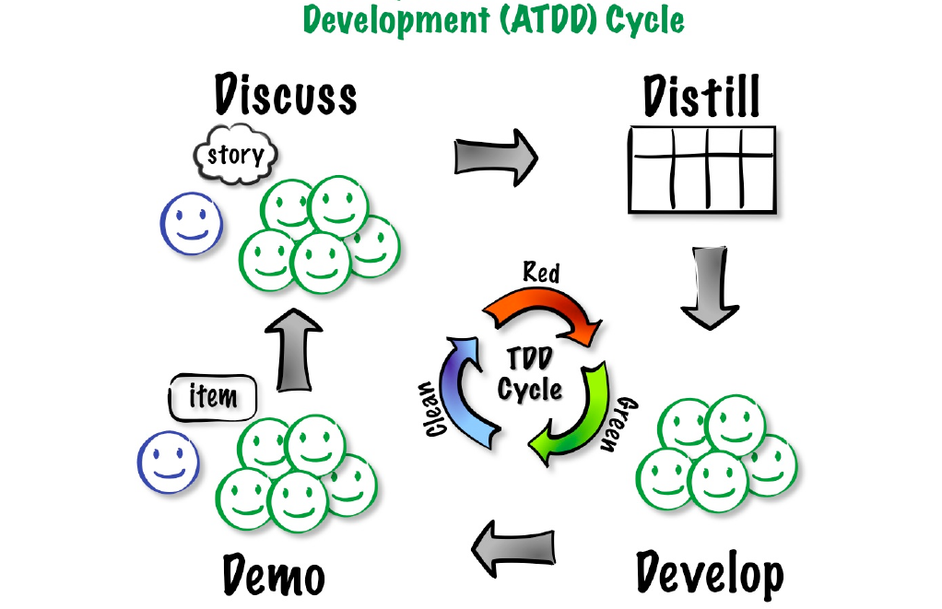
Notes:
https://www.slideshare.net/ehendrickson/introduction-to-acceptance-test-driven-development-3491703
Discuss requirements, create examples, write user stories
Distill examples into acceptance tests
Develop features, hook up tests
Demo features and acceptance tests

Slide 58
Continuous Integration
CI is the practice of merging all developer working copies to a shared mainline several times a day.
Notes:
https://en.wikipedia.org/wiki/Continuous_integration

Slide 59
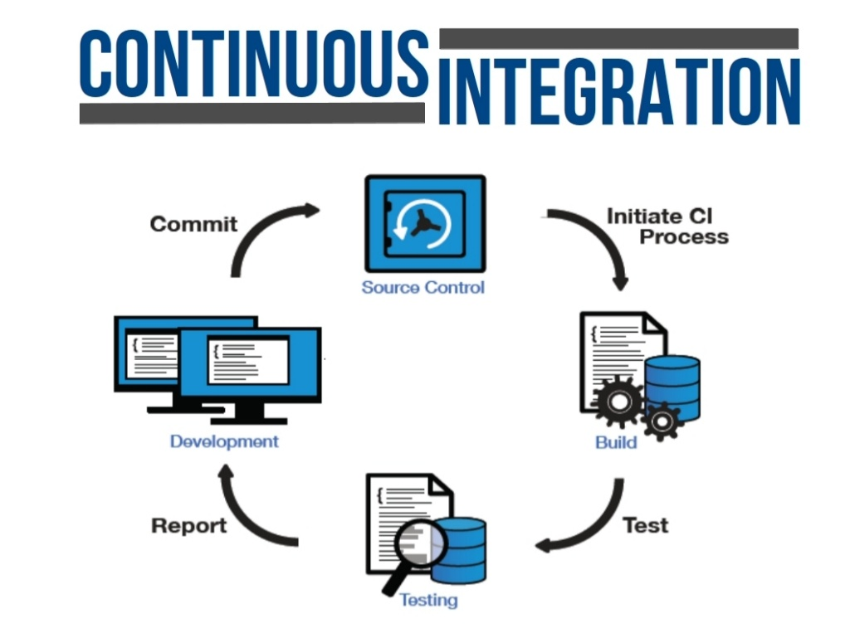
Notes:
Principles:
Maintain a code repository
Automate the build
Make the build self-testing
Everyone commits to baseline everyday
Every commit to baseline should be built
Keep build fast
Test in a clone of production
Make it easy to get the latest deliverables
Everyone can see the result of the latest build
Automate deployment

Slide 60

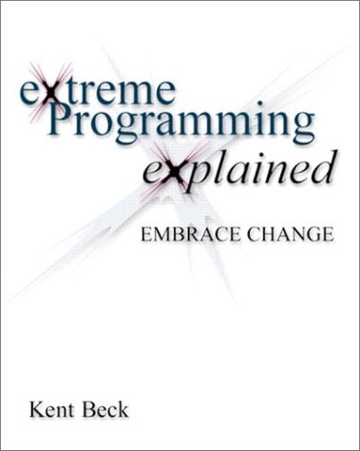
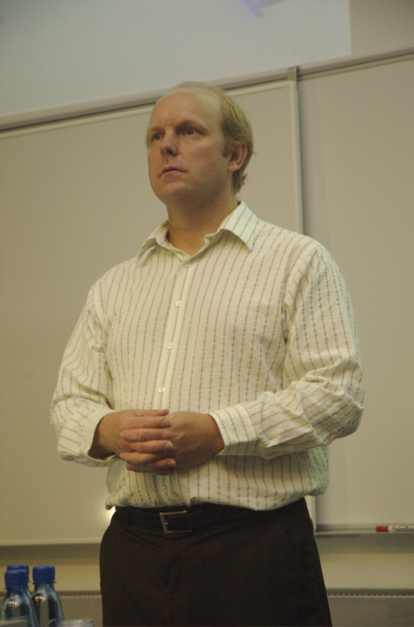
eXtreme Programming
XP is a software development methodology which is intended to improve software quality and responsiveness to changing customer requirements.
Notes:
https://en.wikipedia.org/wiki/Extreme_programming

Slide 61
eXtreme Programming
TDD / ATDD
pair programming
incremental design
simplicity (YAGNI)
clean code
CI
frequent small releases
embracing change
shared understanding (ATDD)

Slide 62
XP is about
writing great code
improving skills and giving up bad habits
keeping the costs of change low
“No matter what the client says the problem is,
it is always a people problem.
Technical fixes alone are not enough.”
Notes:
Quotes from the book:
It is about getting past our adolescent surety that "I know better than everyone else and all I need is to be left alone to be the greatest.
And, it is about writing great code that is really good for business.
XP assumes that you want to grow, to improve your skills, and to improve your relationships. XP assumes you are willing to make changes to meet those goals.
XP is giving up old, ineffective technical and social habits in favor of new ones that work.
If members of a team don't care about a project, nothing can save it.
No matter what the client says the problem is, it is always a people problem. Technical fixes alone are not enough.
XP teams work hard to create conditions under which the cost of changing the software doesn't rise catastrophically. The automated tests, the continual practices and in of improving the design, and the explicit social process all contribute to keep the cost of changes low.
Here's a sad but repeated story: a development team begins applying XP, dramatically improves quality and productivity, but then is disbanded, its leaders fired and the rest of the team scattered. Why does this happen? From the Theory of Constraint perspective, the team's improved performance shifted the constraint elsewhere in the organization.
The way to begin organizational change is still to start with yourself. It is the one change you have control over. First develop your skills, then put them into service.

Slide 63
“A methodology is only as effective as the people involved”

Slide 64
“A significant advantage of TDD is that it enables you to take small steps when writing software. This is a practice that I have promoted for years because it is far more productive than attempting to code in large steps.”
/ Kent Beck /

Slide 65
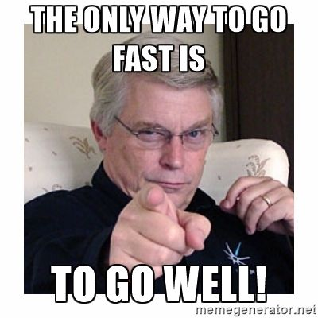
Notes:
“Jót s jól! Ebben áll a nagy titok.” /Kazinczy/

Slide 66
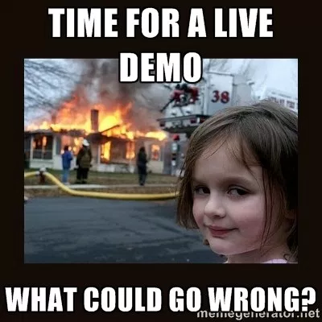

https://github.com/domahidizoltan/presentation-ease-your-life-with-tdd
Notes:
@startuml
actor :User:
cloud api #LightBlue
package "Currency Exchange Service" {
User -down-> [controller] : getRate
}
[controller] -> api : " "
@enduml
------------------------
@startuml
actor :User:
cloud api #LightBlue
package "Currency Exchange Service" {
User -down-> [controller] : getRate
[controller] -down-> [service]
[service] -down-> [repository]
}
[repository] -> api : " "
@enduml
------------------------
@startuml
actor :User:
cloud api #LightBlue
package "Currency Exchange Service" {
package service {
[ExchangePriceCalculator] <- [ExchangePriceCalculatorFactory]
[ExchangePriceCalculator] --> [SimpleExchangePriceCalculator]
[ExchangePriceCalculator] ---> [CryptoExchangePriceCalculator]
}
User -down-> [controller] : getRate
[controller] -down-> [ExchangePriceCalculatorFactory]
[SimpleExchangePriceCalculator] -down-> [repository]
[CryptoExchangePriceCalculator] -down-> [repository]
}
[repository] -> api : " "
@enduml

Slide 67
Resources
https://en.wikipedia.org/wiki/Software_testing
https://martinfowler.com/articles/microservice-testing
https://www.slideshare.net/lemiorhan/the-engines-of-software-development- testing-and-test-driven-development/
http://agiledata.org/essays/tdd.html
https://www.slideshare.net/guestc8093a6/test-driven-development-1000421
https://www.slideshare.net/haochenglee/test-driven-developmentcontinuousintegration
https://en.wikipedia.org/wiki/Test-driven_development

Slide 68

Ease your life with T.D.D.

